Slide 1
Infosys Internship Program
Anomaly Detection
- Mohd Raza

Slide 2
Anomaly Detection
Content:-
Problem statement
Dataset details
Data preprocessing
Clustering results
ML algorithms results
Deep learning – auto encoders
Conclusion

Slide 3
Problem Statement
The goal of this project is to " predict the potentially fraudulent providers " based on the given features in the dataset. Along with this, we will also discover important variables helpful in detecting the behavior of potentially fraud providers.
further, we will study fraudulent patterns in the provider's claims to understand which are the normal transaction and fraudulent transaction i.e. we will detect anomalies in the dataset.
Provider Fraud is one of the biggest problems facing Medicare. Healthcare fraud is an organized crime which involves peers of providers, physicians acting together to make fraud claims.

Slide 4
Problem Statement
Healthcare fraud and abuse take many forms. Some of the most common types of frauds by providers are:
Billing for services that were not provided.
Duplicate submission of a claim for the same service.
Misrepresenting the service provided.
Charging for a more complex or expensive service than was actually provided.
Billing for a covered service when the service actually provided was not covered

Slide 5
Dataset Details
Dataset: Healthcare Providers Dataset
There are 100k rows and 27 columns in the dataset.
Numerical columns are 6 in the dataset
Categorical columns are 18.
Binary categorical columns are 3 only.
Column names are such as National provider Identifier, credential of the provider, Gender, Provider type and address etc.

Slide 6
Data Preprocessing
There are some important steps followed in preprocessing:-
Remove columns like Name, index, Address, zip codes etc.
Remove punctuation like comma(,) from the numerical and categorical data points.
Handling missing values: Handled the missing values by using the imputation for the column having missing values. (EG. Credentials of the provider, gender, name)

Slide 7
Data Preprocessing
Encoding:
Categorical values have encoded with One hot encoding if the values are binary i.e. low cardinality.
Any Categorical value having more than 2 unique values have encoded with Frequency encoding i.e. High cardinality.
Scaling:
Applied Scaling techniques like Standard scalar on both numerical columns and transformed categorical columns.

Slide 8
Clustering
What is clustering?
Clustering is an unsupervised machine learning technique that groups similar data points together.
Identify natural groupings in data to gain insights.
Applications: Customer segmentation, anomaly detection, image segmentation, etc.
Two clustering algorithms have performed during the internship:
K-means
DBSCAN

Slide 9
K-means Clustering
Algorithm Steps:
Initialize k centroids randomly.
Assign each data point to the nearest centroid.
Recompute centroids as the mean of assigned points.
Repeat steps 2-3 until convergence.
Advantage: Simple, efficient and easy to implement.
Limitations: Requires the number of clusters k as input, it is also sensitive to initial placement of centroids.

Slide 10
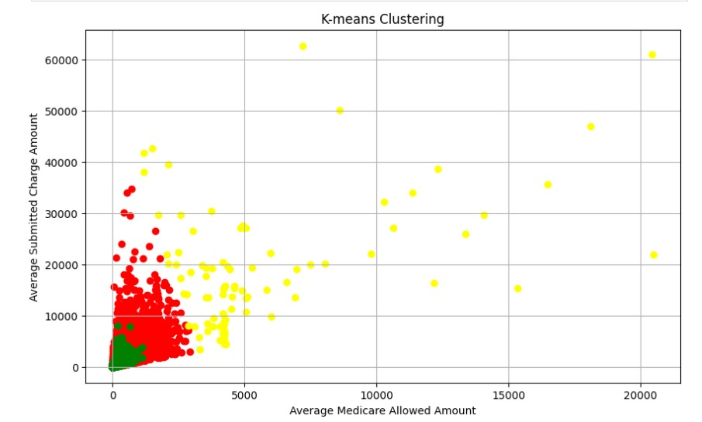
K-means Results
Parameter:
No of clusters k=4
This scatter plot shows the different clusters
Cluster 1 : 66258, red
Cluster 2 : 5, blue
Cluster 3 : 33640, green
Cluster 2 : 97, yellow

Slide 11
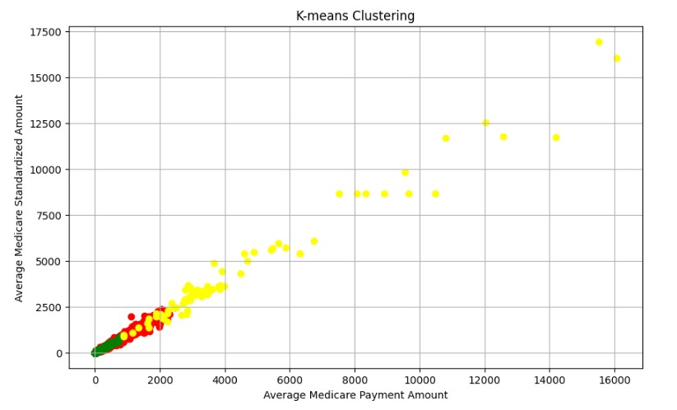
K-means Results
Parameter:
No of clusters k=4
This scatter plot shows the different clusters
Cluster 1 : 66258, red
Cluster 2 : 5, blue
Cluster 3 : 33640, green
Cluster 2 : 97, yellow

Slide 12
DBSCAN - Clustering
Algorithm Steps:
Identify core points based on ‘eps’ (neighborhood radius) and ‘min samples’ (min points to form a dense region)
Expand clusters from core points, connecting density-reachable points.
labels points not in any cluster as noise.
Advantage: Does not require the number of clusters as input can find arbitrarily shaped clusters, handles noise.
Limitations: Requires parameter tuning for ‘eps’ and ‘min samples’, performance degrades with high dimensional data

Slide 13
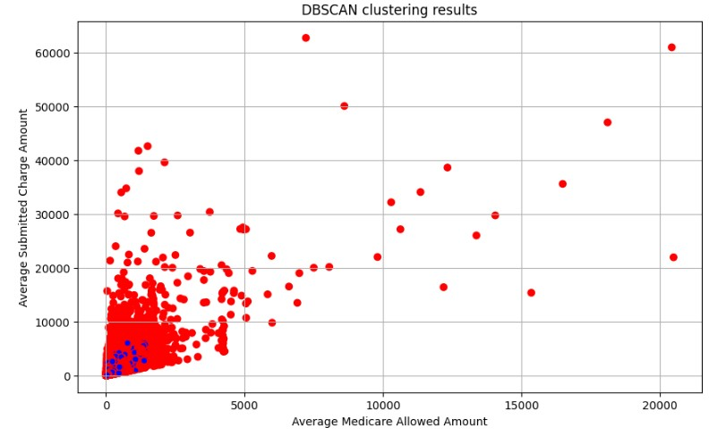
DBSCAN Results
Parameter: eps=1, min_samples=10
Result visualizations:
Scatter plot between the numerical features
red points shows the anomalies
blue points shows the normal points.
There are 2418 anomalies in the dataset.

Slide 14
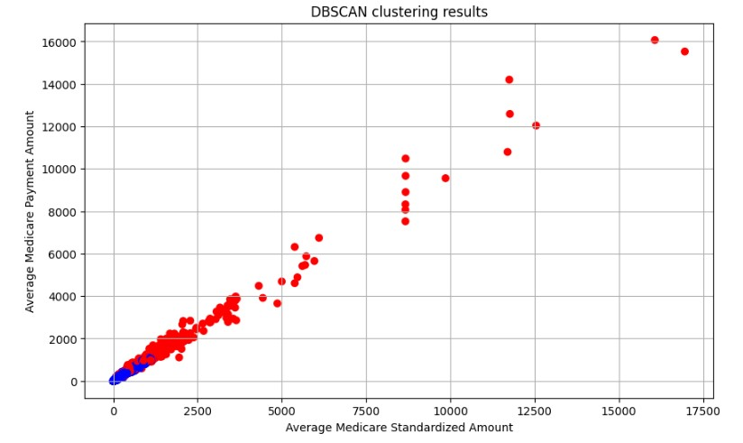
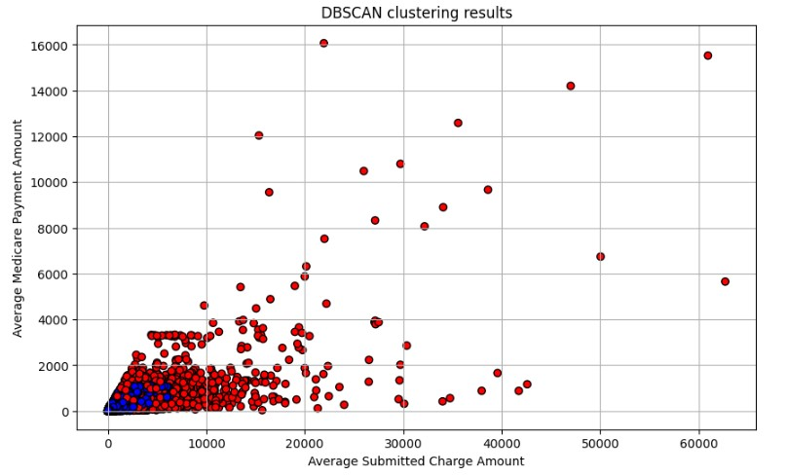
DBSCAN Results

Slide 15
ML Algorithms
There are three ML algorithms specially for anomaly detection performed during the projects which are following:
Isolation forest: Detects anomalies by isolating the observation in a tree structure.
Elliptic Envelope: Assume data follows a gaussian distribution and finds an ellipse that encompasses most of the data.
One Class-Svm: Uses support vector to distinguish between normal and anomalous points.

Slide 16
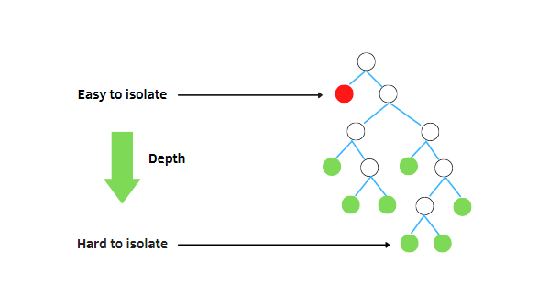
Isolation forest
Algorithm Steps:
Randomly select a feature and a split value.
recursively partition the data until each observation is isolated.
anomalies require fewer splits to isolate.
Advantage: Efficient, scales well with large datasets.
Limitations: Assumes anomalies are few and different from the normal data.
Source: https://pub.towardsai.net/interpretation-of-isolation-forest-with-shap-d1b6af93ae71

Slide 17
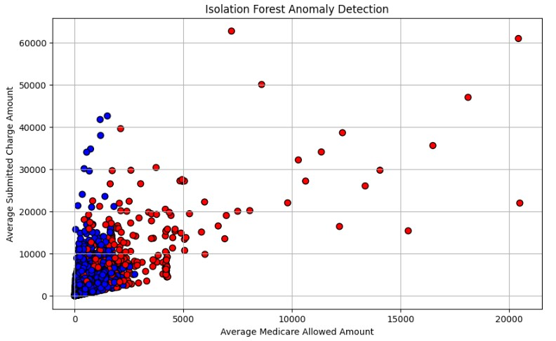
Isolation forest Results
Parameter: n_estimators=200, contamination=0.01
Result visualizations:
Scatter plot between the numerical features
Red points shows the anomalies
Blue points shows the normal points.
There are 1000 anomalies in the dataset.

Slide 18
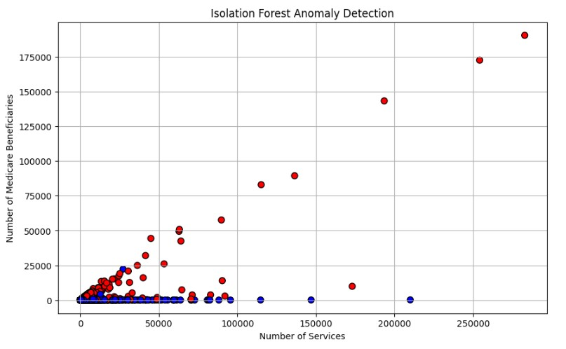
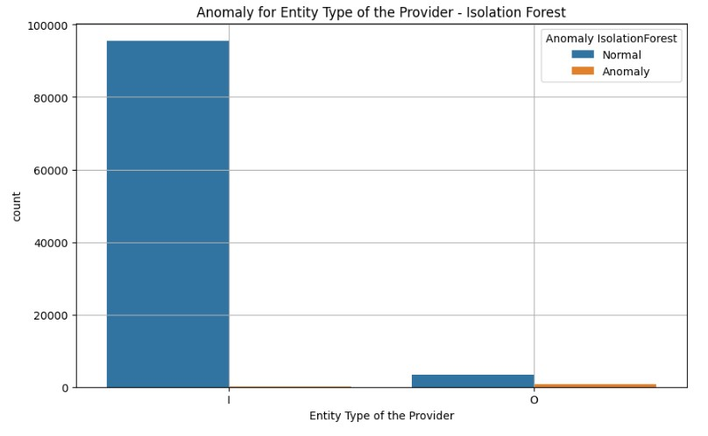
Isolation forest Results

Slide 19
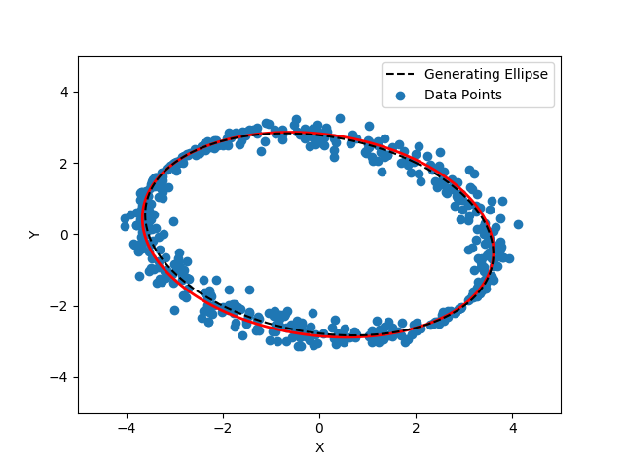
Elliptic envelope
Algorithm Steps:
Fit an ellipse to the data assuming a gaussian distribution.
Identify points outside the ellipse as anomalies.
Advantage: Simple to understand and implement, works well with Gaussian data.
Limitations: Assumes the data follows a Gaussian distribution.
Source: Stack Overflow

Slide 20
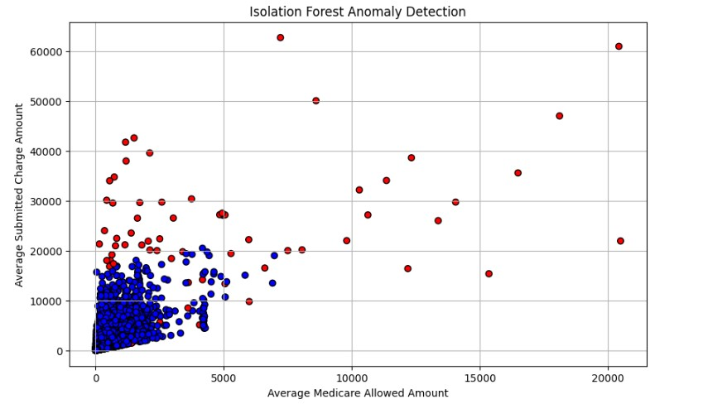
Elliptic Envelope Results
Parameter: contamination=0.01
Result visualizations:
Scatter plot between the numerical features
Red points shows the anomalies
Blue points shows the normal points.
There are 1000 anomalies in the dataset.

Slide 21
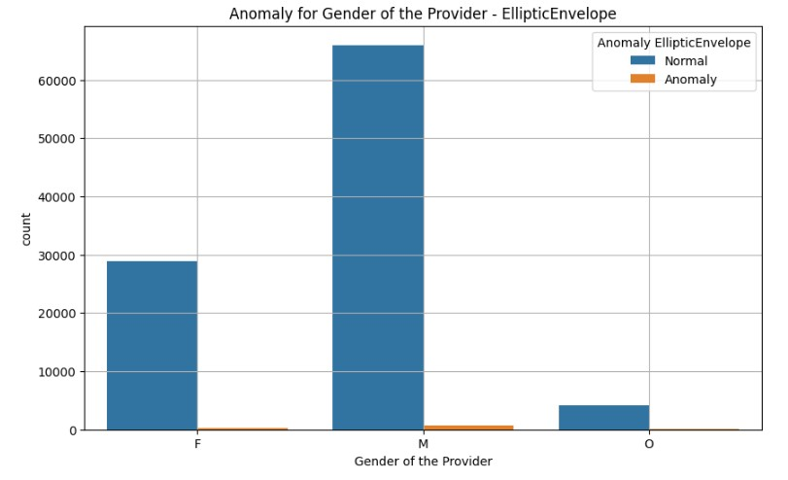
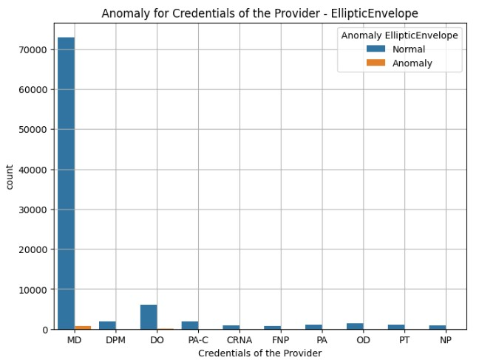
Elliptic envelope results

Slide 22
Autoencoders
Definition: Autoencoders are neural networks that learn to encode data into a lower-dimensional representation and then decode it back.
Components:
Encoder: Compresses the input data.
Decoder: Reconstructs the input data from the compressed representation.
Loss Function: Measures reconstruction error.
Application: Anomaly detection by leveraging reconstruction error.

Slide 23
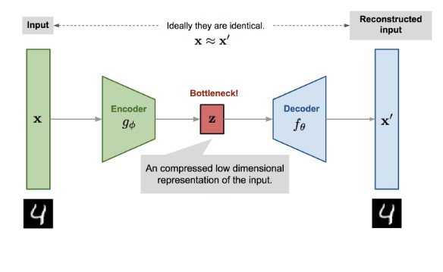
Autoencoders
Architecture
Source: Kaggle

Slide 24
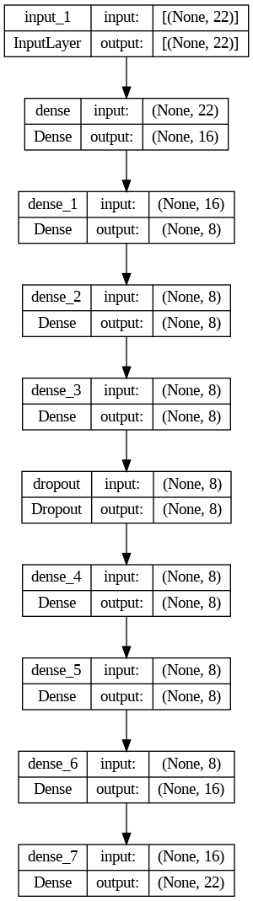
Autoencoders - Results

Slide 25
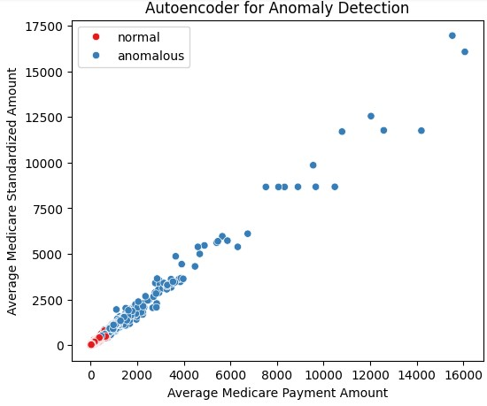
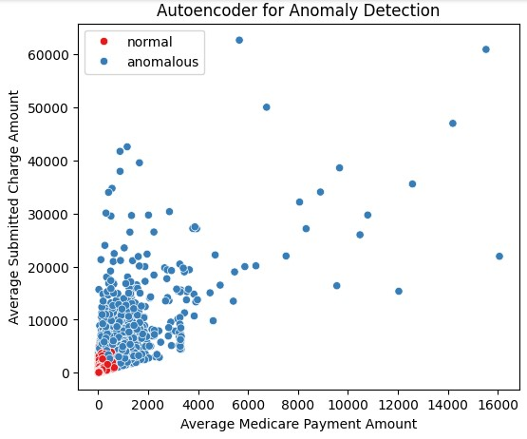
Autoencoders - Results

Slide 26
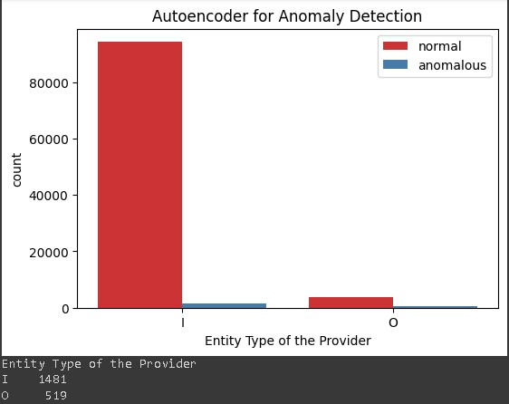
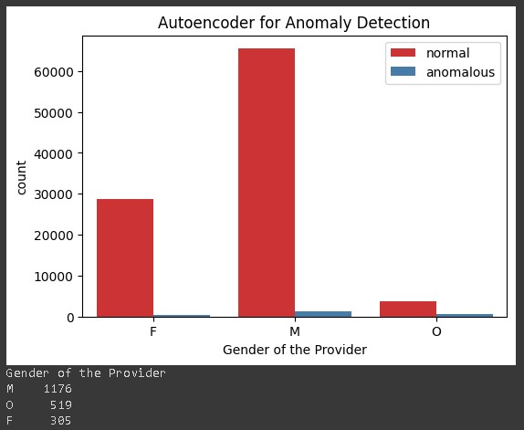
Autoencoders - Results

Slide 27
Conclusion
In this project, we explored multiple anomaly detection algorithms to identify and isolate anomalies in our dataset. The algorithms implemented include k-means, DBSCAN, elliptic envelope, isolation forest, and autoencoders.
Each algorithm offers a unique approach to anomaly detection, leveraging different methodologies and assumptions to identify outliers effectively.

Slide 28
Thank you

